Slide 1
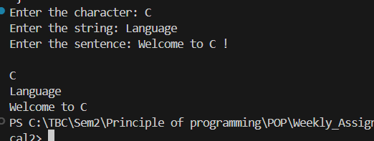
Task 1:
#include <stdio.h> int main()
{ char ch; char str[50]; char sen[99]; printf("Enter the character: "); scanf("%c",&ch); printf("Enter the string: ");
// Amper sign & is not used during array of character
//cause the variable itself acts as a pinter. scanf("%s",str); printf("Enter the sentence: ");
// using scanset"%[^!]" prints the sentence before exclamation mark scanf("%[^!]s",sen); printf("\n%c\n",ch); printf("%s",str); printf("%s",sen); return 0;
}
OUTPUT:

Slide 2
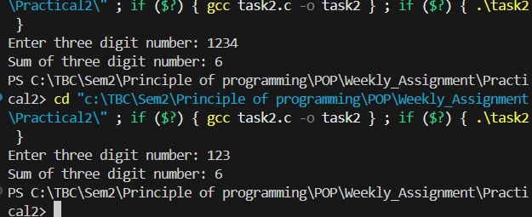
Task 2:
// Given a three-digit integer print the sum of its digits.
#include <stdio.h> int main()
{ int num,sum=0,temp; printf("Enter three digit number: "); scanf("%3d",&num); if (100<=num && num<=999)
{ for(int i =1;i<=3;i++)
{ temp=num%10; sum = temp+sum; num/=10;
}
/*It finds and adds(remainder which is last digit) from the last number until the num becomes 0*/
} printf(“Sum of three digit number: %d",sum); return 0;
}
OUTPUT:

